Slide 1

Building on the Stethoscope and Beyond the Bedside – Using Informatics Solutions to Treat Healthcare
Paulo B. Pinho, MD – Clinical Informatics, Board Certified
November 6, 2025
Notes:
Building on the Stethoscope and Beyond the Bedside: Using Informatics Solutions to Treat Healthcare
This essential lecture examines how modern healthcare must move beyond traditional methods—like the stethoscope—to adopt a data-driven, technology-enabled, and clinically led future. Participants will explore the critical role of Informatics Solutions in addressing complex population trends, the demand for personalized care, and mounting provider workflow challenges. The session will break down the complexities of data standards, interoperability, and structured clinical data, while demonstrating the immense value of unstructured patient data in completing the full healthcare story. Attendees will learn actionable strategies for leveraging technology to achieve comprehensive, evidence-based, and equitable care delivery models.

Slide 2
Faculty Disclosure Information
I have the following financial relationships with the manufacturer(s) of any commercial product(s) and/or provider(s) of commercial services discussed in this CME activity:
Stock/Bonds in: Lumeris Health, Cohere Health
Consultant for: Emtelligent, EMCNL
I will give a balanced presentation using the best available evidence to support my conclusions and recommendations.
I do not intend to discuss an unapproved/investigative use of commercial product/device in my presentation.
You are not permitted to create any alterations of this presentation or to use it for commercial or other purposes without the prior written permission of the Conference or the Presenter.

Slide 3
Learning Objectives
Achieving a Holistic View of Patient Information, Improving Patient Care and Driving Innovation in Healthcare Through Leveraging Clinical Data Agnostic of Source
At the conclusion of the presentation participants should be able to:
Understand how a data driven, tech-enabled and clinically led future are necessary to meet evolving population trends, medical complexity and the need for personalized care, changing care delivery models and provider workflow challenges
Appreciate the complexities of data standards, interoperability and structured clinical data
Understand the value of unstructured data to complete the stories of healthcare journeys
Explore how technology can be used for comprehensive, evidence based and equitable care

Slide 4
Changes You May Wish to Make in Practice
Achieving a Holistic View of Patient Information, Improving Patient Care and Driving Innovation in Healthcare Through Leveraging Clinical Data Agnostic of Source
Implement strategies to leverage automated tools for data management and analysis.
Incorporate a holistic, data-agnostic approach to patient information to improve clinical decision-making.
Consider the adoption of innovative technologies to enhance diagnostic capabilities and patient care.

Slide 5
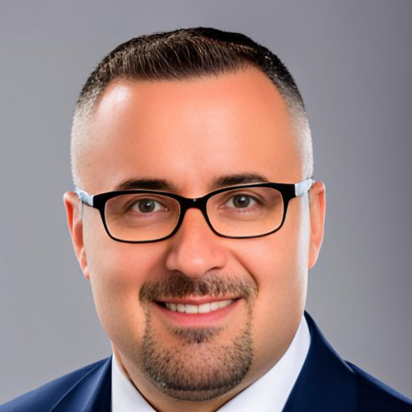
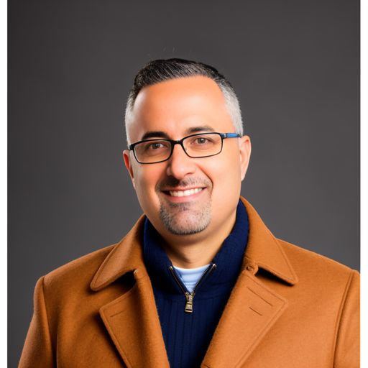

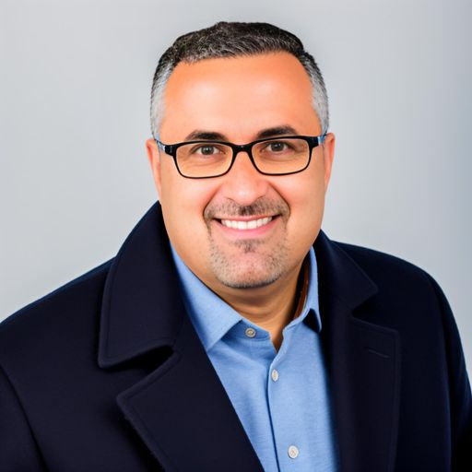


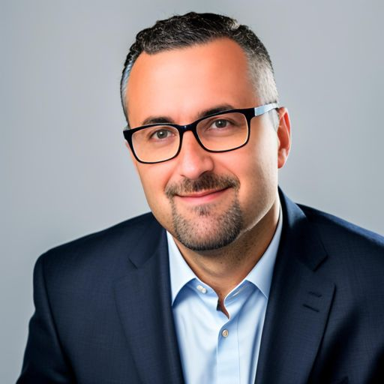
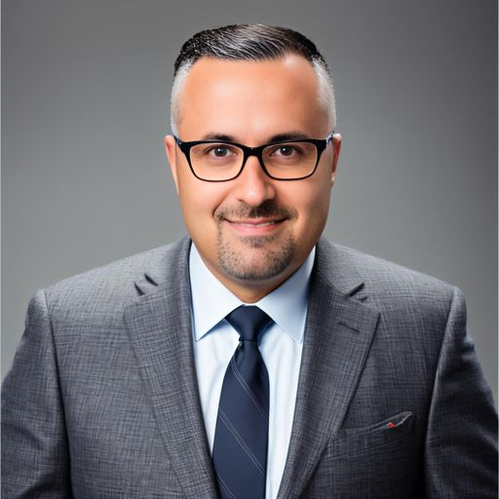
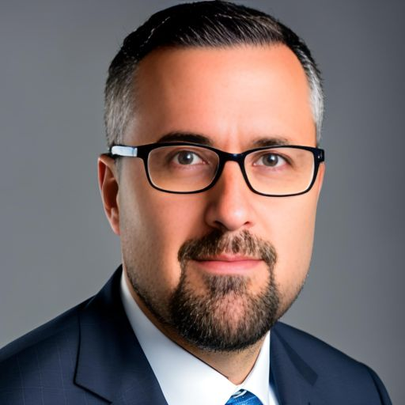
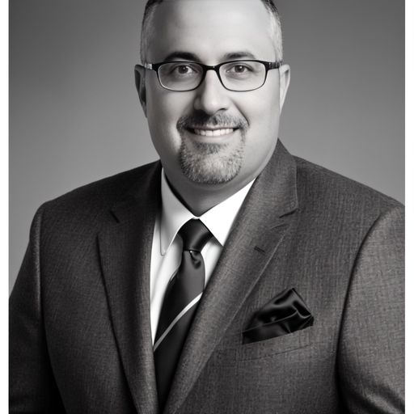
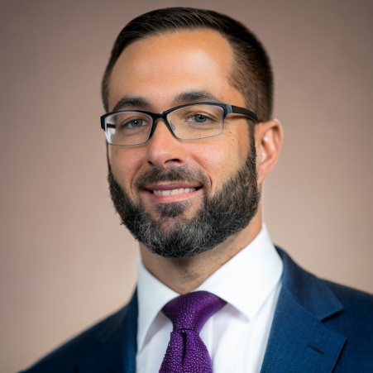
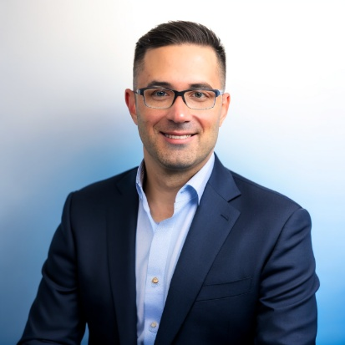
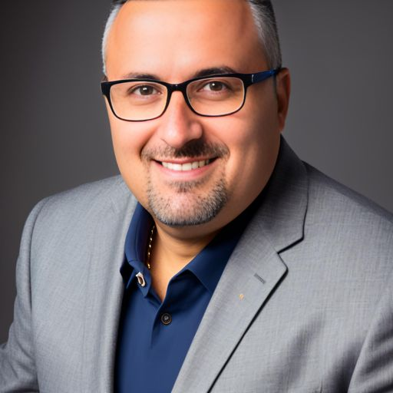
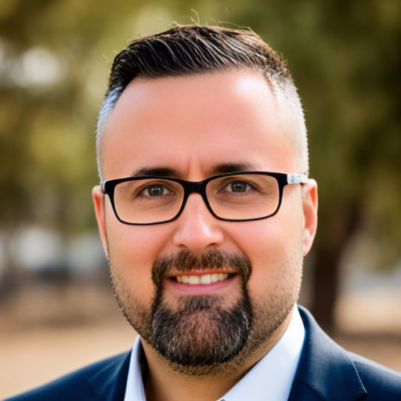
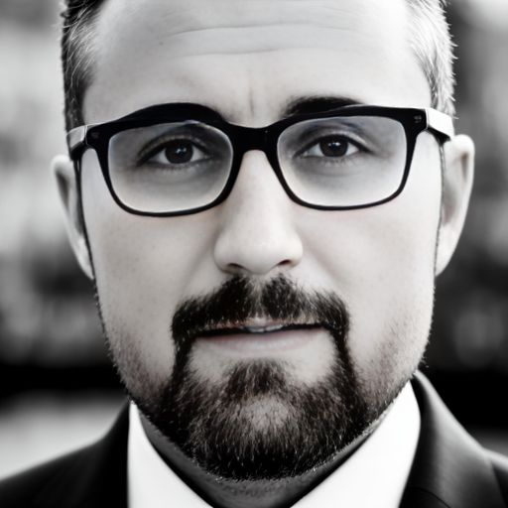
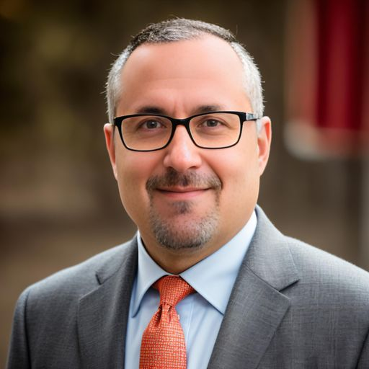
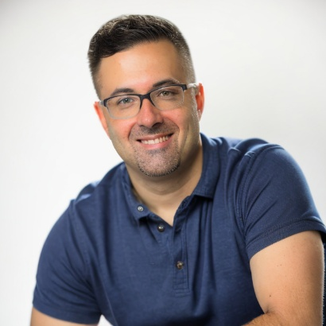

The Many AI Faces of Me
The Many AI Faces of Me

Slide 6
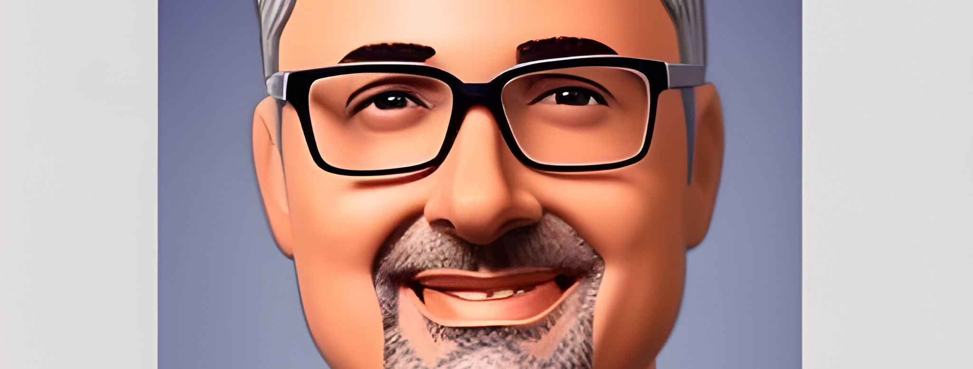
Cartoon Me

Slide 7

Visionary Me

Slide 8

Special Agent Me

Slide 9

Pixar Me

Slide 10
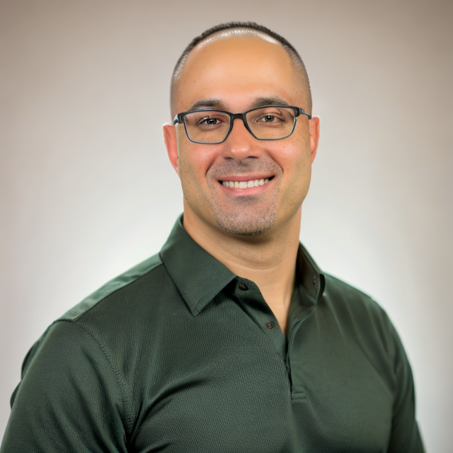
Male Pattern Baldness Gym-going Me

Slide 11

Call 777-BAD-PAIN Me

Slide 12
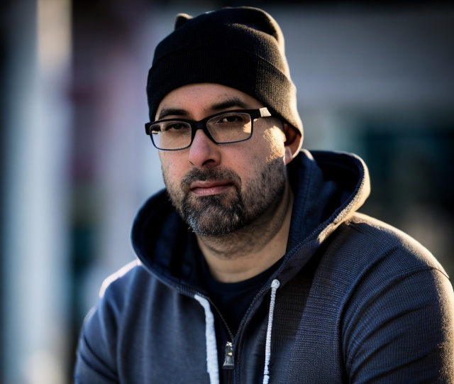

EmineME

Slide 13


Runway Me

Slide 14
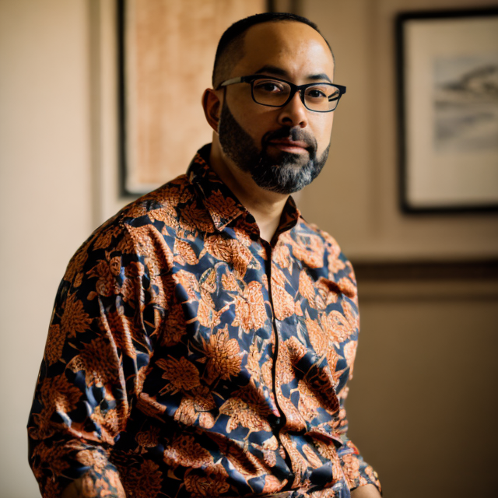

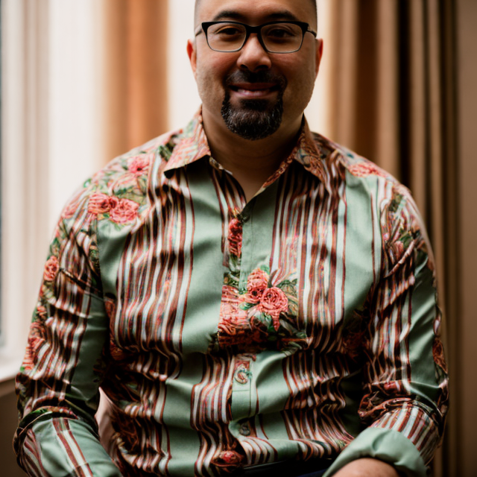
I’m Pretty Sure this is NOT Me

Slide 15
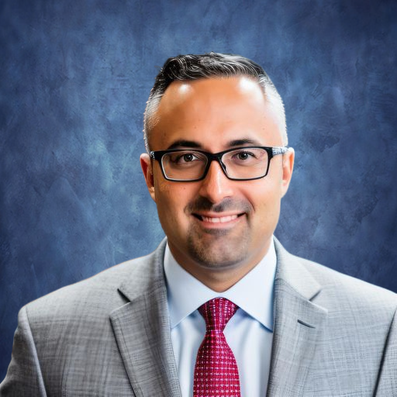
The AI Me I Want to Be

Slide 16
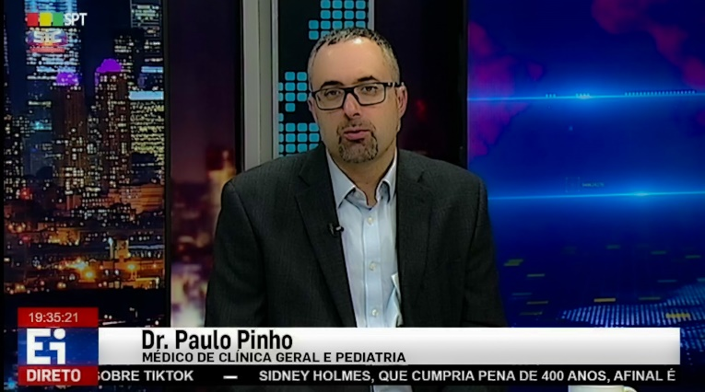
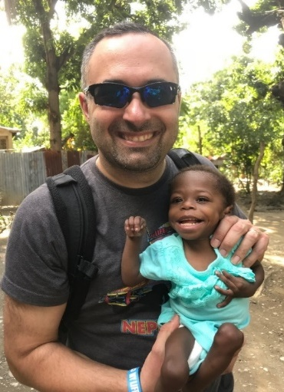
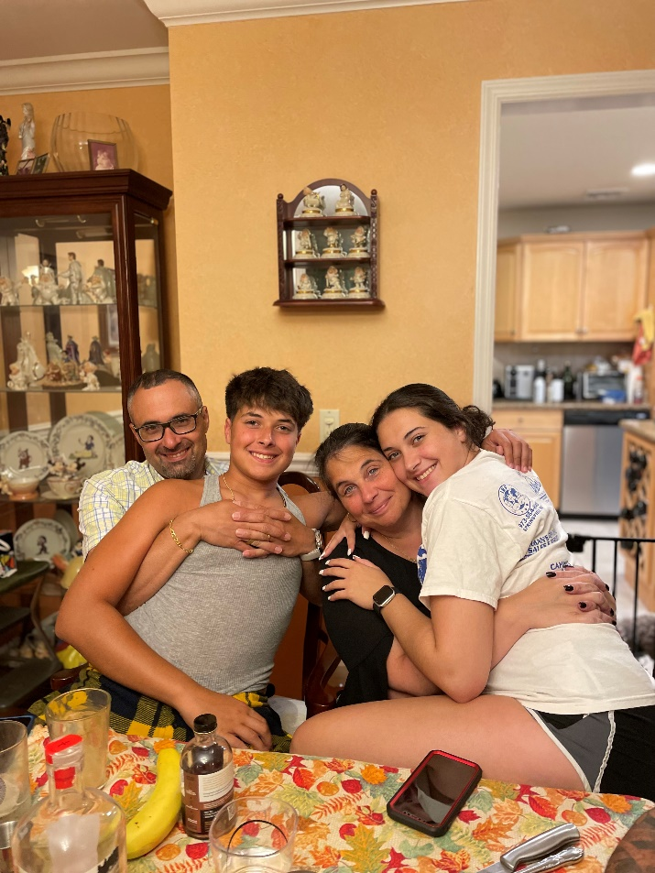
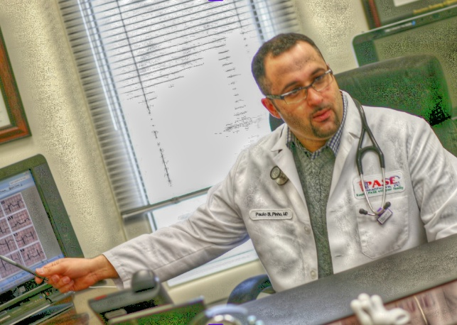
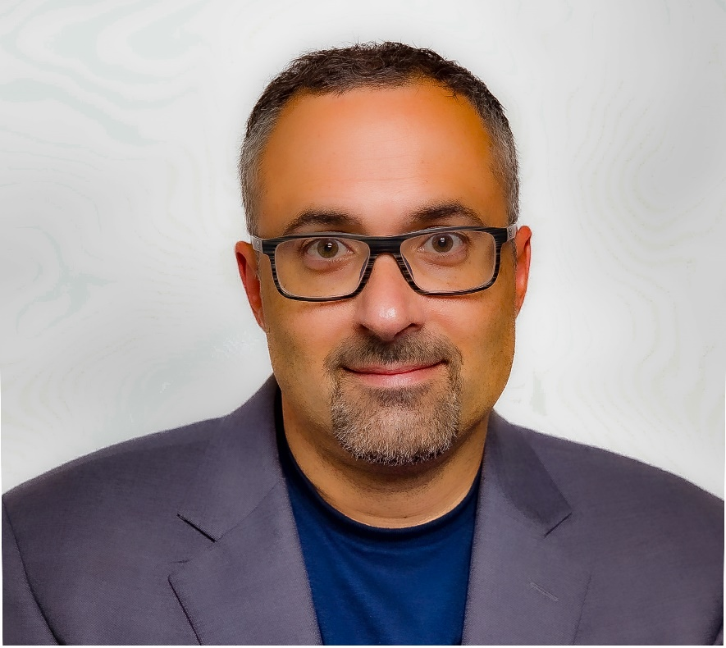
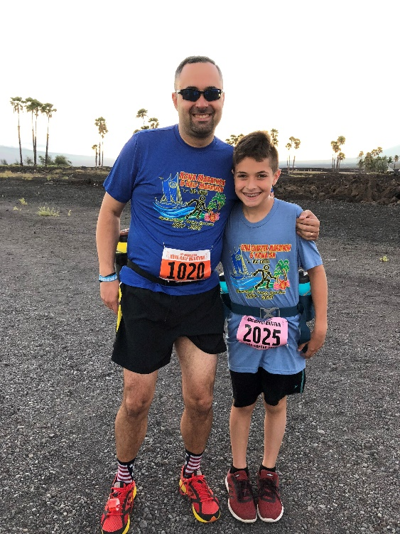
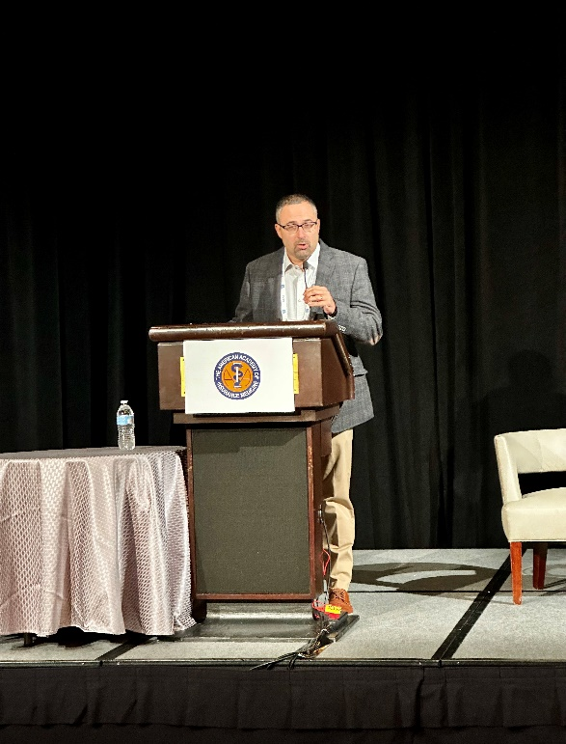
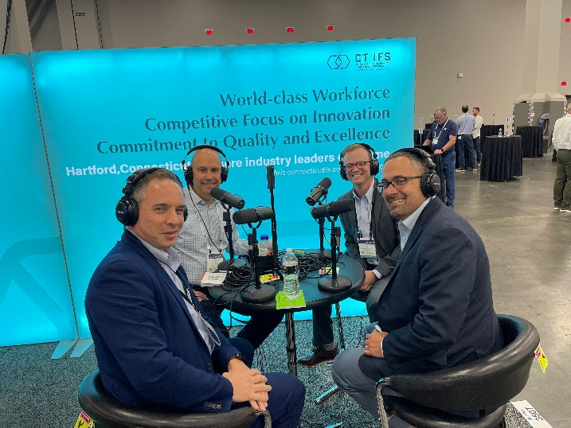
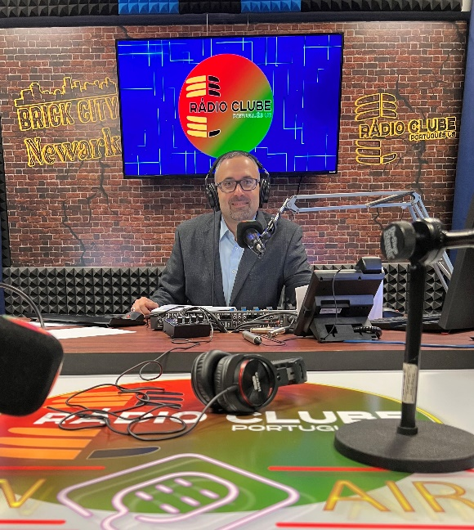
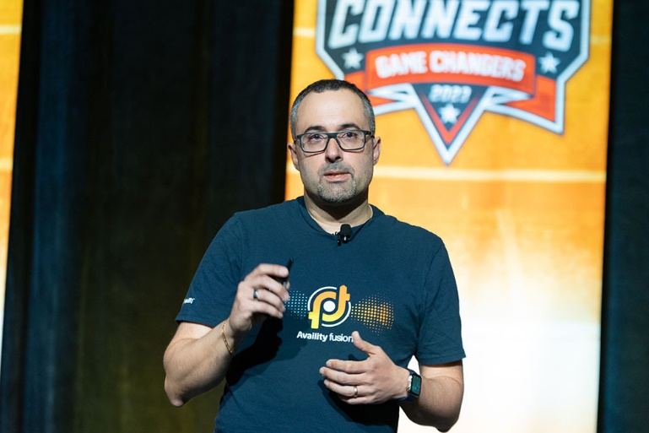
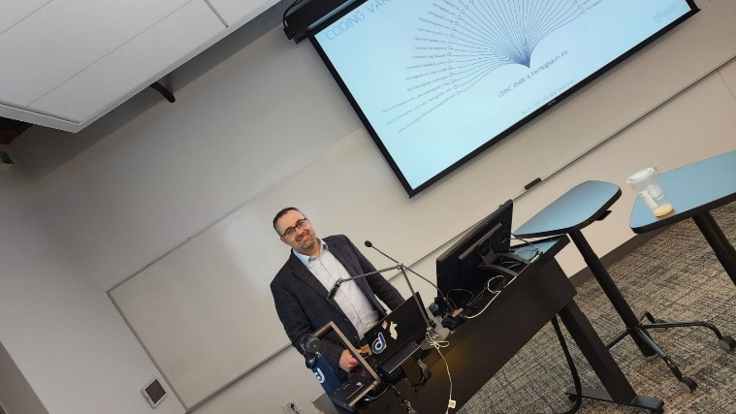
The Real Me

Slide 17
So, What are the Issues?
Data - How do we ascertain reliable, consistent and equitable data to drive ML and AI models? Not Human Replacement – Human Assist - How do we keep the human in the loop? Outputs - How do we represent the output? Outputs - Who is the audience? Are they ready for it? Outcomes - Does representing a finding yield an actionable opportunity to make a difference? Value - Does the actionable opportunity move the needle for healthcare? Cost - Do the false positives cost too much? Cost - Do the false negatives cost too much?

Slide 18
Agenda
What is Clinical Informatics? A Multipronged Problem Resolved by The Human Flight Path Standards – My Path to Clinical Informatics - But Standards Didn’t Cut It Pediatric Hypertension Case Study – CDSS on Normalized Data Medication Instruction Parsing – NLP/AI on Normalized Data Predictive Models/AI solutions can Help Right Size Healthcare for All Ecosystem Players Falls Frailty Skin condition and skin cancer Final Thoughts

Slide 19
What is Clinical Informatics?

Slide 20
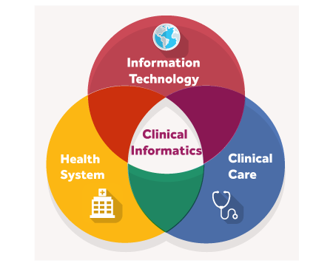
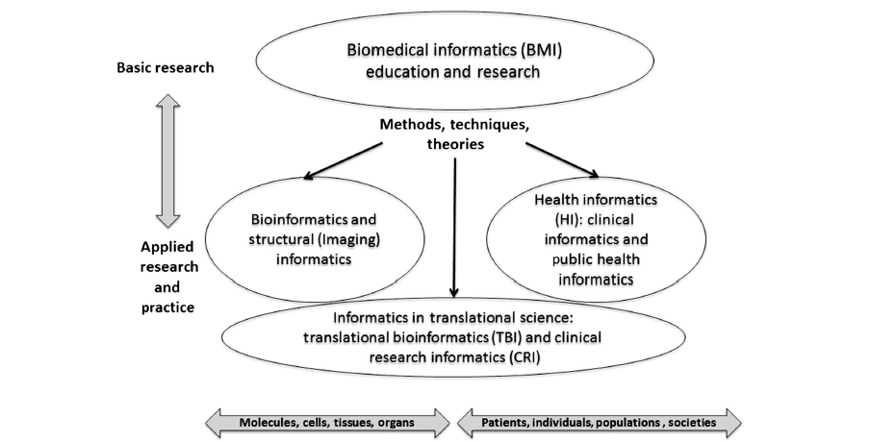
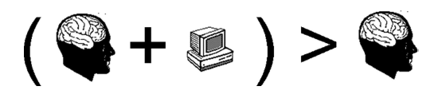
What is Clinical Informatics?
In the Literature
Kulikowski, 2012
Clinical Informatics Fellowship Overview (kumc.edu)
Friedman, 2009
Notes:
Foundational Knowledge – standards
Enhancing health decisions
Building health information systems
Data governance, management and analytics
Leadership

Slide 21
A Multipronged Problem Resolved by The Human Flight Path

Slide 22

A Multipronged Problem
Waste &
Misuse
Changing Demographics
Reduction in Medical Providers
Increasing Care Fragmentation
The Cost of Care Delivery
18%
57M
117K
7–29
315K
Of U.S. GDP on healthcare, nearly double more than the next developed nation
The number of people over 65 in 2020 (17% of the population)
Physicians left the workforce in 2021.
Only 40K joined.
The number of providers the average senior sees in a year
The amount the average couple over 65 will spend on healthcare costs over the course
of retirement.
25%
2035
3.2M
20%
5%
of all Healthcare spending is wasteful with nearly $100b coming from overtreatment or low value care
The year people over 65 will outnumber people under 18
The shortage of healthcare workers
by 2026.
Of seniors are readmitted within 30 days of a hospitalization. And less than half follow up after hospitalization.
The amount healthcare costs will increase annually, outpacing Medicare per-capita spending projections
Notes:
There is perpetual address of “chronic illness”, reactive care
Multimorbidity
Noncommunicable disease
The most complex patients have the most complex care delivery models
Less than 50% of elderly patients are up to date with screenings
Elderly patients take up to 19 medication doses daily
Multiple care providers
Yearly – 7 doctors across 4 practices
Surgical patients see 27 different care providers
1 in 5 doctors plans to leave practice in the coming years – 30% of all healthcare workers
2/3 of physicians report burnout – COVID contributed substantially
2019-2020 Nursing and Respiratory Therapy vacancies increased by 30%
Residency programs

Slide 23


Perfecting Transcontinental Flight
Flying a plane requires the perfect combination of automation, data savvy and human intervention
20TB x 2 x 6 x 365
Human intervention is crucial for a safe landing. Pilots are required to communicate with the autopilot system and input parameters such as altitude, speed, and glide slope. This intervention guides autopilot to execute the landing.
Amount of data generated per engine per hour
Engines/
737
Hours/ transcontinental flight
Days/Year
One 737 flying once daily transcontinental generates 87,600 Terabytes of data per year from its engines alone, this doesn’t include weather, air traffic, passenger data, etc.
— HP

Slide 24


Medical Headwinds - The Need for Speed and Scale in Managing Data has Never Been Greater
Automation is critical to generating insights from data
Annual Patient Generated Data Is Surging Globally
— Connor Stewart, Statista, 2020
A single patient generates approximately 80 megabytes of data each year in EMR and imaging data.
— Suter-Crazzola, Clemens. (2018). Better Patient Outcomes Through Mining of Biomedical Big Data. Frontiers in ICT. 5.
Healthcare organizations have seen an 878% increase in health data growth since 2016, reaching 8.41 petabytes (PB) in 2018.
— Dell EMC
2314 Exabytes
153 Exabytes
2013
2020

Slide 25


Medical Headwinds - Dedicated Medical Talent is a Key Differentiator
Medical knowledge explosion requires dedicated talent to triage for relevance
Time to Double Medical Knowledge is Decreasing
— NCBI, Challenges and Opportunities Facings Medical Education, Peter Densen, MD, 2011
Reading…“two articles per day out of the six million medical articles published annually, in one year, they would fall 82 centuries behind in their reading.”
— Miser, WF, Critical Appraisal of the Literature. J Am Board Fam Pract, 12 (4) 315-333. 1999.
“What was learned in the first 3 years of medical school will be just 6% of what is known at the end of the decade from 2010 to 2020.”
— Densen, P., Challenges and Opportunities Facing Medical Education. Trans Am Clin Climatol Assoc. 2011; 122: 48-58.
50 Years
7 Years
3.5 Years
73 Days
1950
1980
2010
2020

Slide 26
Standards, My Path to Clinical Informatics – But Standards Didn’t Cut It

Slide 27
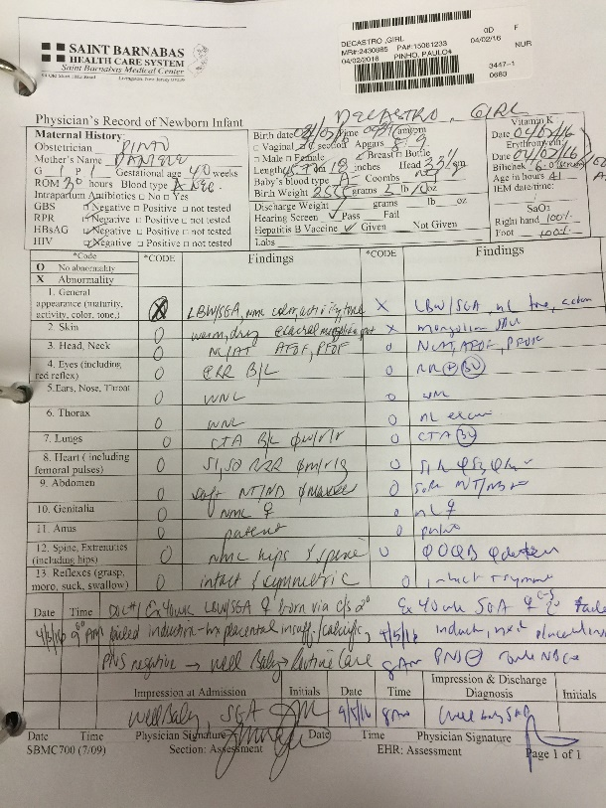
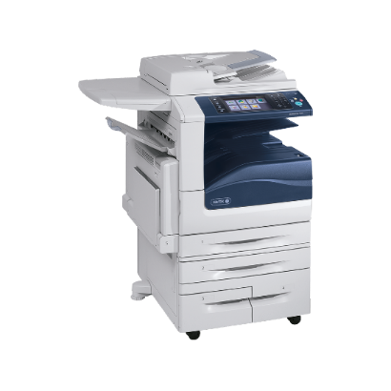

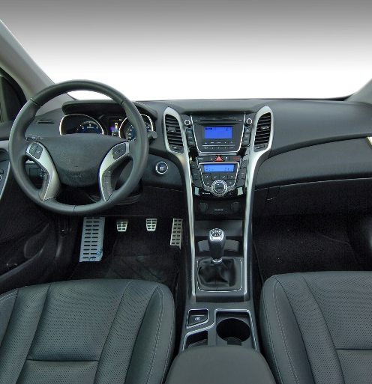
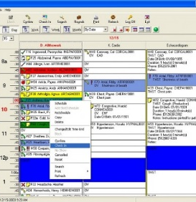

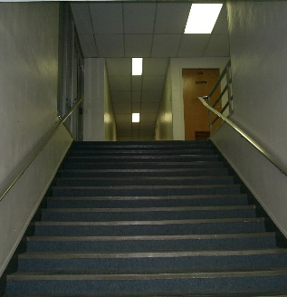
My EHR Journey – 2006-2016
10 years of solving semantic interoperability without scale

Slide 28



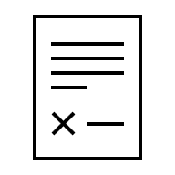
My EHR Journey – 2006-2016
10 years of solving semantic interoperability without scale
C-CDA/XML
C-CDA/XML

Slide 29
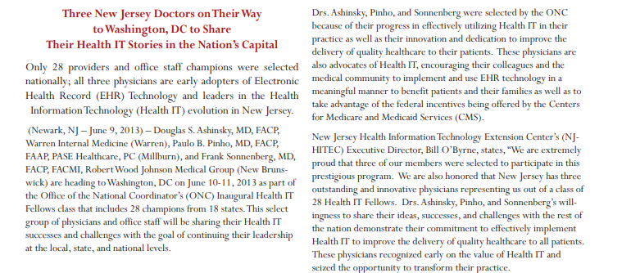
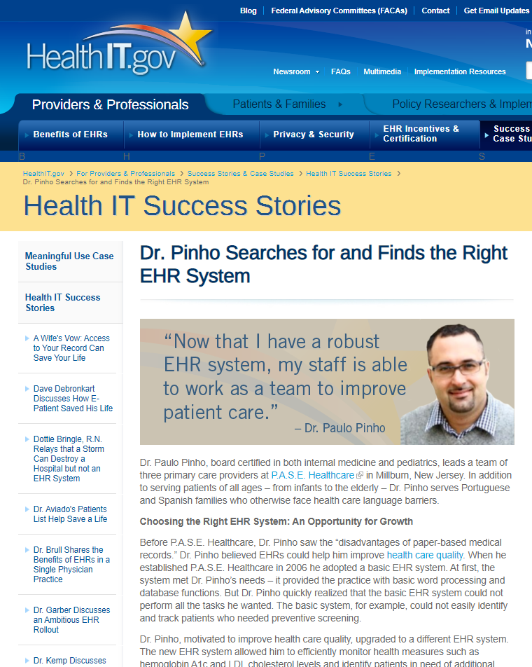

My Personal Why
So, I Looked for Scale in 2013
Positive Provider Feedback
There is a reduction in phone calls. They take charge of their own health and are engaged and active.
— Anonymous office manager, small group practice
Before EMR’s we couldn’t track mammograms and colonoscopies.
We went from 5% to 90% knowing where people are at.
—Dr. Pinho, PCP small group practice
Filling prescriptions is a lot safer and easier.
—Anonymous PCP in small group practice

Slide 30
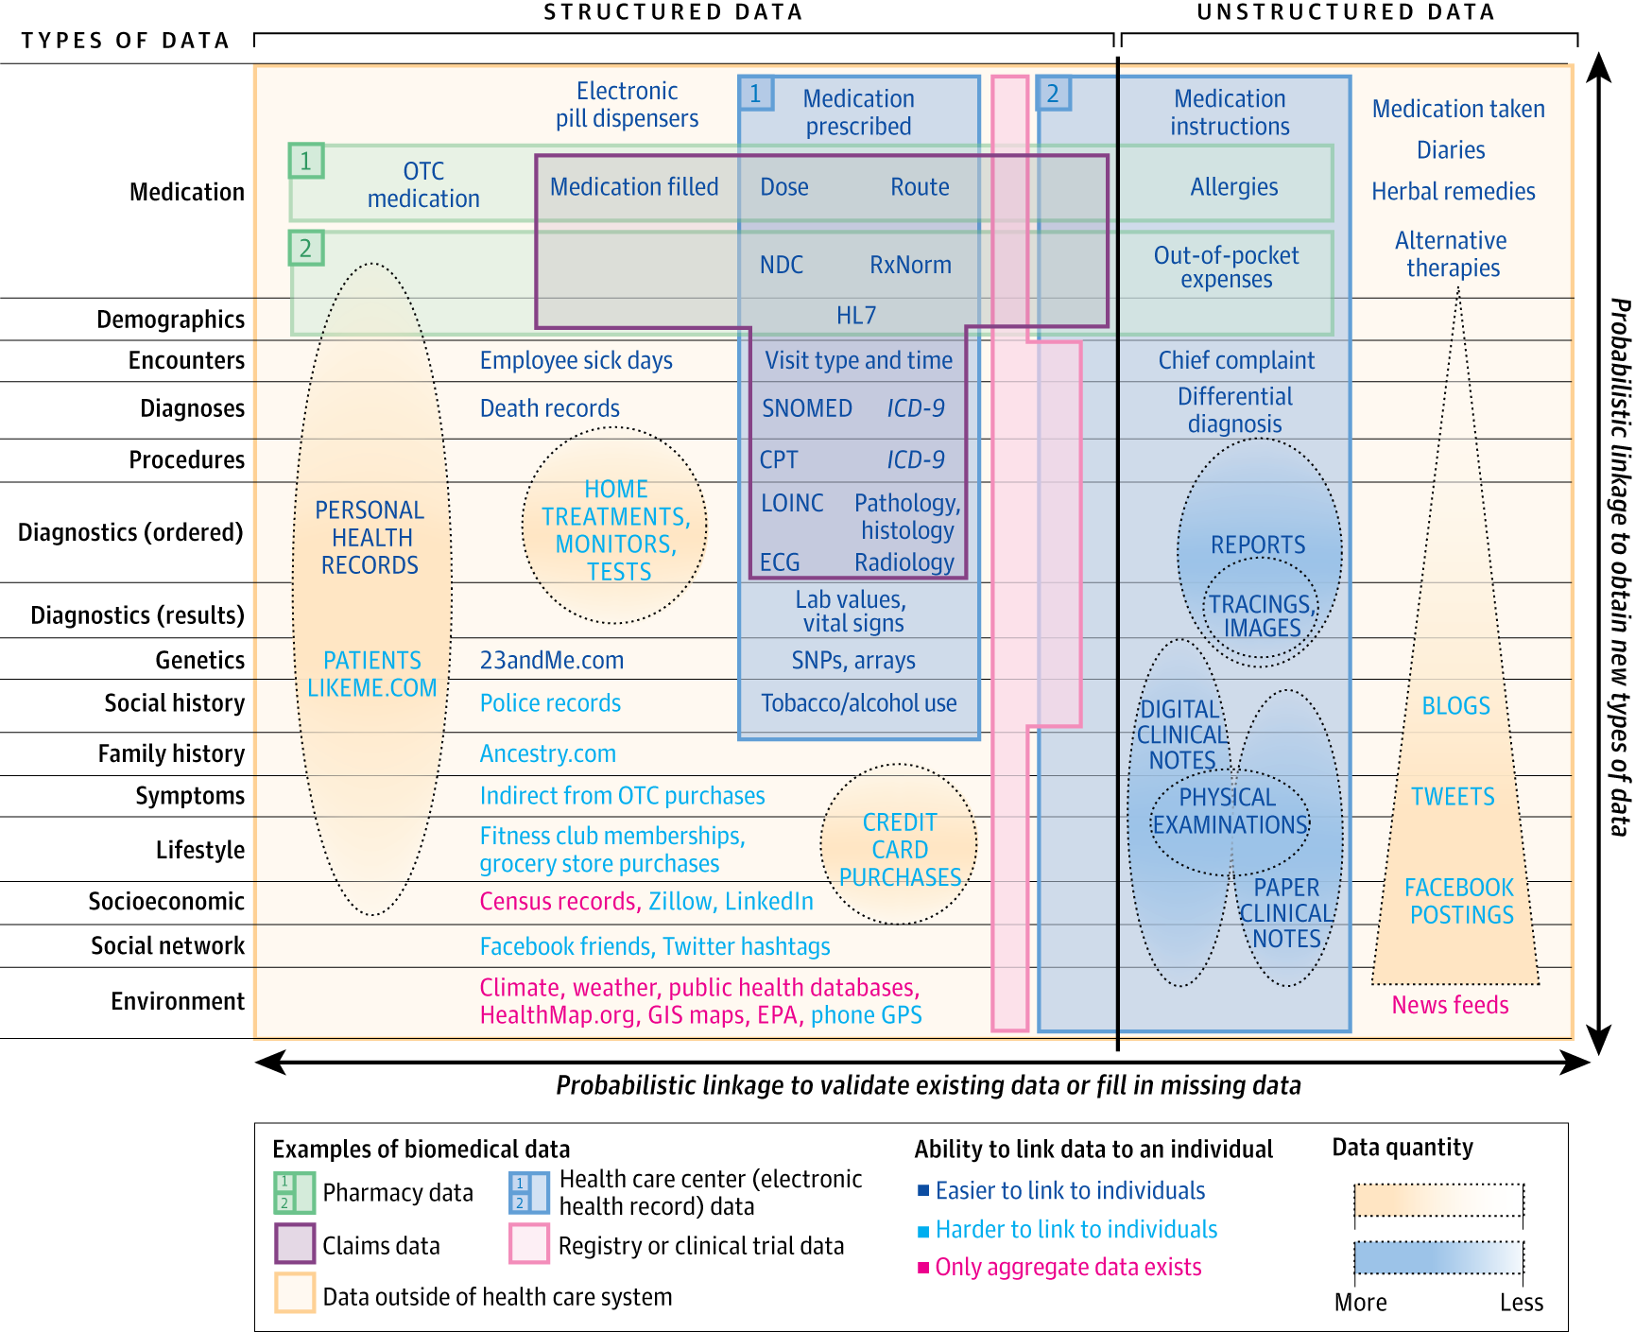
Clinical Data Scope
https://jama.jamanetwork.com/article.aspx?articleid=1875648
https://georgevanantwerp.com/2014/05/27/great-bigdata-jama-image-missing-some-data-sources/

Slide 31
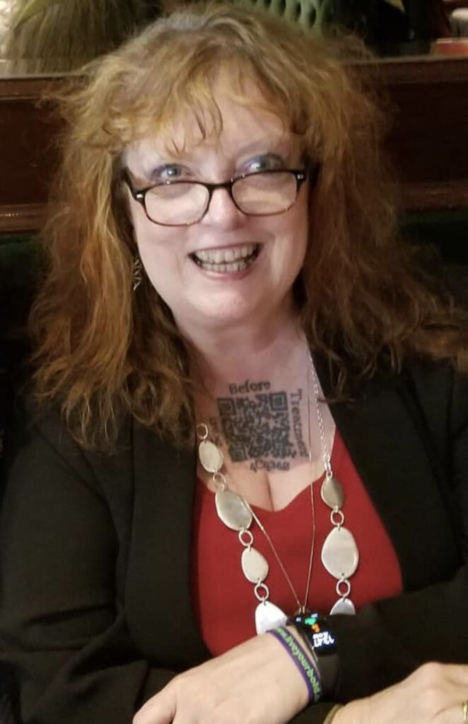
. . .And then there is the Mighty Casey
Casey Quinlan’s QR code highlights a consistent issue in healthcare
Woods, S. S., Oldenburg, J., van Leeuwen, D., Sarasohn-Kahn, J., & Hudson, M. F. (2023). An Extraordinary Voice Expressed Through Humor: A Tribute to Casey Quinlan. Journal of participatory medicine, 15, e54527. https://doi.org/10.2196/54527
Notes:
Why did I do this? Because I’ve been waiting for the medical-industrial complex to deliver on their promise of health information exchange (HIE), the promise that they’ve been making for years, but have yet to fork over. I can, and do, securely move money around the globe at the click of a mouse. I do it via bank accounts, purchase agreements, contracts with clients. Most people do. But my healthcare record — which is MINE, as much as it is the property of the medical providers who gave the care it describes — is in fractured bits and pieces all over everywhere.
2023 died in hospitce

Slide 32





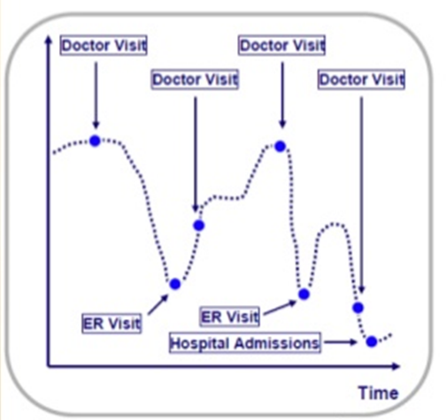
Patient Care – Fragmented
Courtesy Availity Clinical Solutions
Patients are Required to Provide Their Own Data as Well as Sparse and Non-Interoperable Data from Clinical Encounters
Patient Provided
Data
Primary Care
Data
Gastroenterology
Data
Urgent Care
Data
Emergency Room
Data
https://www.slideshare.net/HowardRosen129/the-future-of-mhealth-jay-srini-march-2011
Notes:
2000 electronic health records, each with their own language and dialect. There are now 200ish. Different implmenetaitons.

Slide 33
Current Unrealistic Expectations of Patient Documentation
Physician Internal Monologue
Physician Documentation Into EHR in SOAP format (semi-structured)
EHR codification of semi-structured data into structured fields
EHR outbounding structured data to end user
End user wanting to abstract physician inner monologue for use case
Notes:
And this is a challenge that exists in the life insurance realm.

Slide 34
Actual Patient Documentation Experience
A 58-year-old Caucasian, Non-Hispanic, Catholic male
with Past Medical History of Hypertension reported
Medications: Amlodipine 5 mg PO QD
presents to an urgent care center on a Saturday morning at 9:30 AM with Chief Complaint of a Head Laceration
History of present Illness - he sustained it during a fall at home “while gardening.” He states that he was walking in the back yard when he tripped on a brick in his pavers that was sticking up. He had no dizziness or lightheadedness, had no chest pain, shortness of breath, he denies weakness. He was able to get up under his own power and other than a bleeding head laceration, has no symptoms.
With the exception of the above – Review Of Systems was negative
BEST
Physician Internal Monologue
Physician Documentation Into EHR in SOAP format (semi-structured)
EHR codification of semi-structured data into structured fields
EHR outbounding structured data to end user
End user wanting to abstract physician inner monologue for use case
A 58-year-old male
with Past Medical History of Hypertension reported
Medications: Amlodipine
Chief Complaint of a Head Laceration
History of present Illness – Head Laceration after fall
Review Of Systems neg
WORST
Notes:
My work with the ACORD standards organization – premised on clinical data standards
Abandon using EHR because it doesn’t look like the PDF.
This doesn’t take into consideration complexities like medical synonyms and polysems as well as the fact that in some cases there is local representation of concepts

Slide 35
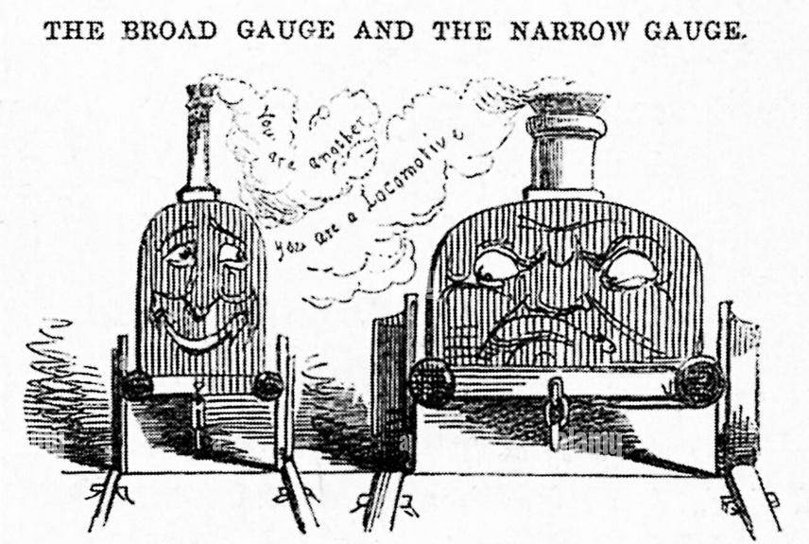
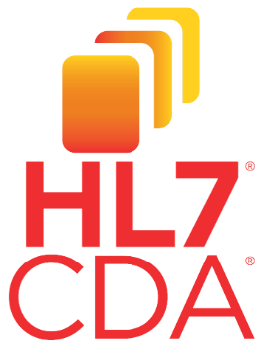
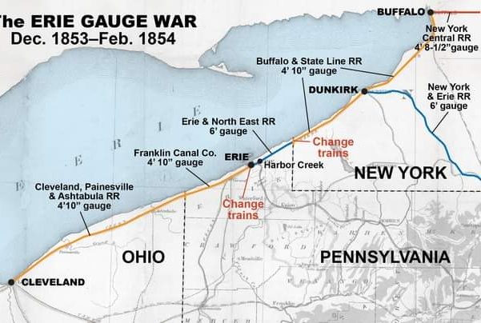
The Evolution of Standards
Critical to Many Disciplines
ClinicalDocument
recordTarget
This identifies patient and has demographic info
structuredBody
Sections break up different clinical content
section
text (unstructured and one per section)
This shows up for human display
entry (machine readable content)
This machine- readable content can be used for exchange & apps
entry (often multiple per section)
Sections can be added and re-used between different documents
… (additional sections)

Slide 36
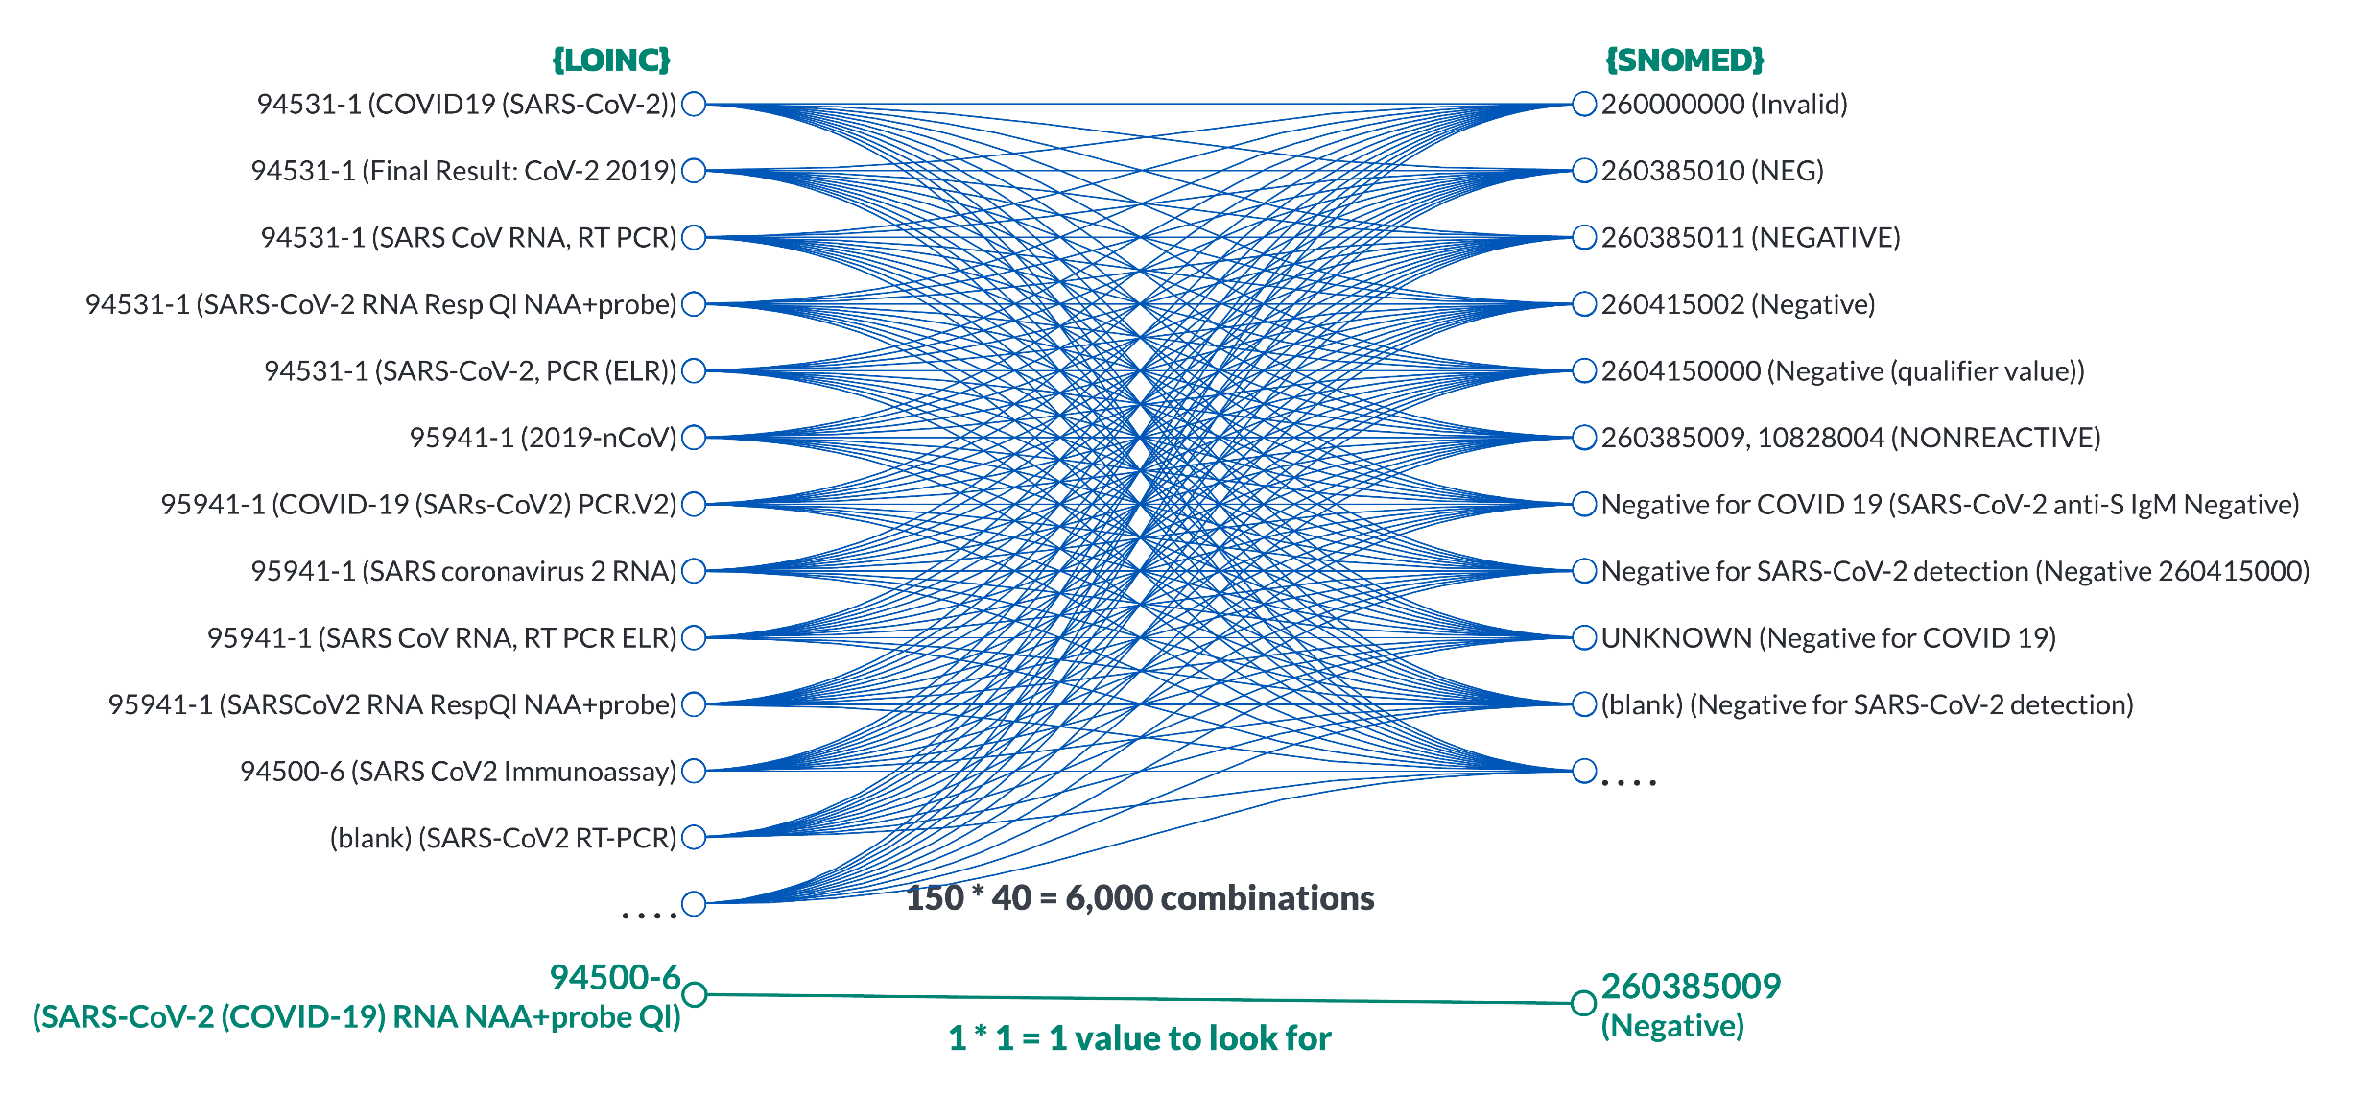
The Wild West of Clinical Coding Magnified with COVID-19
Courtesy Availity Clinical Solutions
It Starts with Normalization
Notes:
700,000 different codable concepts and their permutations. Imagine the complexity of these interactions

Slide 37
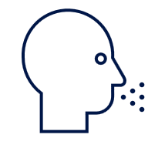




Clinical Data Gaps
How can we improve healthcare when:
Allergies
80% | of allergies aren’t coded appropriately (30% no code at all)
70% | of lab results don’t use right vocabulary or units (45% with no LOINC)
40% | of medications don’t have right coding for quality measures¹
Results
Medications
Procedures
NEARLY
Problems
1. D’Amore et al. Using Clinical Data Standards to Measure Quality: A New Approach. Applied Clinical Informatics. 2018

Slide 38
Magnitude of the Problem
Coding Variation Increases Exponentially Across Clinical Domains
10
major clinical domains
Single Clinical Document:
All Clinical Domains*
>2,000
LOINC codes for major lab tests
Increasing amount of complexity and variation across clinical domains
>100
descriptions and codes tied to single LOINC code
Single Clinical Domain:
All Labs
Single Lab Test:
A1c LOINC Code
* Clinical Domains include: medications, immunizations, problems, allergies, encounters, procedures, plan of care, and labs and vital signs.

Slide 39

Patient Access Mandate Moves Healthcare into Modern Age
Delivering interoperability actually gives patients the ability to manage their healthcare the same way they manage their finances, travel and every other component of their lives. This requires using modern computing standards and APIs that give patients access to their health information and give them the ability to use the tools they want to shop for and coordinate their own care on their smartphones.
— Don Rucker, M.D. National Coordinator for Health IT

Slide 40

Patient Care – Defragmented – I Found My Scale in 2021
Courtesy Availity Clinical Solutions
70% of Patients Want Personalized Care, but Care Model Constraints Keep Clinicians from Delivering
Despite data ubiquity, complex patients of variable medical literacy need to tell their story time and time again across care settings
Patient Provided
Data
Primary Care
Data
Gastroenterology
Data
Urgent Care
Data
Emergency Room
Data
https://www.slideshare.net/HowardRosen129/the-future-of-mhealth-jay-srini-march-2011

Slide 41

Pediatric Hypertension Case Study – CDSS on Normalized Data
Paulo B. Pinho, MD, FAAP, FACP, Vice President and Medical Director*
Sam Schifman, Chief Architect*
Pranjal Paliwal, MS Student in Data Science ¥
Leah Mitchell, MS Student in Data Science ¥
Chun-Kit Ngan, Professor ¥
Rachel Rosow, 2nd Year Medical Student ǂ
* Diameter Health (Farmington, CT)
¥ Worcester Polytechnic Institute (Worcester, MA)
ǂ Frank Netter School of Medicine (North Haven, CT)

Slide 42


Pediatric Hypertension
Solutions - Interoperability
Notes:
Pediatric HTN prevalence is estimated at 4%
76% of pediatric HTN undiagnosed and 6% of patients who merit treatment receive it, leaving 1.5 million children in the US undiagnosed and untreated
Pediatric HTN Is well linked to adult cardiovascular disease (CVD).
Adulthood CVD accounted for 21% of the deaths in the U.S. in 2020
There is a higher prevalence of underdiagnosed adult and pediatric HTN and CVD in lower socioeconomic groups.
By 2030, 40.5% of the US population will have CVD, with the total direct CVD medical costs alone expected to triple from $273 billion to $818 billion in that timespan.
To address these medical and social issues, we developed a rule-based CDSS tool that will:
Sit on top of a provider’s EHR system.
Screen pediatric patients and diagnose hypertension.
Advise on HTN workups and treatments.
Produce results independent of data cleanliness
Longitudinal and normalized data was better
5 patients were over diagnosed, but this is OK

Slide 43
Medication Instruction Parsing – NLP/AI on Normalized Data
Paulo B. Pinho, MD, FAAP, FACP, Vice President and Medical Director*
Sam Schifman, Chief Architect*
Kewal Mishra, MS Student in Data Science ¥
Madeline Chudy, MS Student in Data Science ¥
Chun-Kit Ngan, Professor ¥
* Diameter Health (Farmington, CT)
¥ Worcester Polytechnic Institute (Worcester, MA)

Slide 44

Handwriting and Unstructured Text Recognizer
Use Case: Medication instructions present great variability and source of interpretation error
Prescriber Information
Signature
(abbreviated Signa or Sig)
These include:
The method of administration or application
The dose if the preparation is for internal use
The time of administration
The diluents (ie. Water) or means of application (ie. Brush)
The part of the body where the preparation is to be used
Any special instructions or conditions of use
DEA Number
Patient Information
Date of Prescription
Superscript (Recipe)
Inscription (Medication Prescribed)
Subscription (Instructions for Pharmacy)
Signatura (Directions for Patient)
Provider Signature
Notes:
Medical errors are arguably the 3rd or 4th largest cause of death
100,000’s experience medication errors that are not reported
$40 billion in cost, let alone psychological pain and suffering
1/3 are related to EHR documentation and 1/3 of med mal cases involve medication errors
Transitions of care

Slide 45

Performance of Medication with Normalization, +NLP and +Gen AI

Slide 46
Predictive Models and Artificial Intelligence can Help Right Size Healthcare for All Ecosystem Players Payer – HEDIS, Risk Adjustment and Utilization Management Provider – CDSS, Diagnostic Adjuncts Patient – Care Management, Patient Navigation Tools

Slide 47


Predictive Models Can Prevent Life-Altering Outcomes
In mid-September of 2023, 80-year-old Edith was brought into the Emergency Department after a trip and fall sustaining a right femoral neck fracture
Edith has a significant medical history, but also a social decline
She was noted to be anemic with a hemoglobin of 6.8 g/dL (L) on admission and was guaiac positive with tarry black stools
Edith’s fall could have been prevented.
Notes:
80M seniors in CMS sponsored delivery models
¼ of these will fall annually
Each fall treated in the outpatient setting incurs, $9,133-$13,507 to treat
Inpatient falls double the cost, burdening the system with a $29B spend
Falls are a challenge to predict with a human eye on discrete, fragmented data.

Slide 48




Slide 49


Falls Risk Output
Predicted vs. Actual

Slide 50


Model Performance
Model Performance Cohort of 24,000 Medicare Advantage Patients
Metric | Result
AUC | 0.85
Positive Predicted Value | 0.58
Negative Predictive Value | 0.96
Sensitivity Patients with relative morbidity risk of > 2.5x | 0.94
Specificity | 0.99
Number Needed to Identify | 1.71
Results using an XGBoost classification model

Slide 51
Frailty Detection and Management
Enhancing Interventions with Interpretable Machine Learning
Members: Aayush Sangani, Dalton Macres, Madelyn Marcotte, Sheroz Shaikh and Sreeram Marimuthu
Sponsors: Paulo Pinho, MD & Jacob Dodd

Slide 52


Executive Summary
Project Objective
Methodology
Develop robust frailty models to predict adverse events and guide targeted interventions for the aging population, addressing the growing burden of frailty on patients & healthcare systems
Feature Engineering: Extract meaningful features using clinical and claims data (e.g., LACE Index, comorbidities)
Frailty Detection: Identify frailty onset within one year
Frailty Modeling: Create phenotype and mortality models to assess patient risk
Notes:
1/5 people in US to be 65+ by 2030, up from 1/6 in 2020, 1/20 in 1920
Mean annual cost
$6k robust
$9K prefrail
$20k frail
This does not account for the social and psych impacts to the patients themselves
LACE readmission
https://www.spglobal.com/marketintelligence/en/news-insights/latest-news-headlines/1-in-5-americans-to-be-65-years-old-or-older-by-2030-86270288

Slide 53




Phenotypes AUC up to 0.985
Best model For Each Target Phenotype - were evaluated on unseen data for all 53 Phenotypes over 6 experiments with Calibration curves, Feature Importance plots, ROC Curves, and the best performing model were logged.
Notes:
MCBS Patient Data - Medicare Current Beneficiary data
CFI and SFI Tables – financial data
ELIXHAUSER – severity of comborbidtities, HCC, and ADL Grouped Features

Slide 54

Frailty Prediction
Test RMSE_30F – 0.0052
Notes:
RMSE 0 Euclidian distance between true values and predictions. The smaller it is the better.

Slide 55

Cox PH Model Results
Modeled patient mortality
with a Concordance
index of 0.84

Slide 56









Impact
Our Solution
Frailty Phenotype Modeling
Identify at-risk patients
Frailty Detection
Predict frailty onset
Mortality Modeling
Assess patient risk
Outcomes
Informed Interventions
For the right patients
Reduce Burden of Frailty
Social, psychological, and
financial burdens
Notes:
Outcomes:
Inform interventions for high-risk patients where an impact is possible.
Reduce healthcare costs and burdens (social, psychological, financial)

Slide 57


Using Deep Learning and GenAI Approaches for Classifying Diverse Skin Cancer Types and Providing Diagnostic Recommendations
DermETAS-SNA LLM assistant:
Dynamically learns skin-disease classifiers
Medically informed descriptions to facilitate clinician-patient interpretation
Experimental evaluations on 23 skin disease categories
Overall F1-score of 56.30% > SkinGPT-4 (48.51%)
Domain-expert evaluation – 8 MD for 7 conditions with 92% (better than SkinGPT4 by 48.20%)
Proof-of-concept prototype with practical feasibility for real world clinical and educational applications
Notes:
DermETAS-SNA LLM assistant:
Dynamically learns skin-disease classifiers
Trained Vision Transformer (ViT) tailored for dermatological feature representation
Fine-tuned binary classifiers for each of the 23 skin disease categories
StackNet architecture integrating ViT classifiers to enhance prediction and reduce class imbalance
Medically informed descriptions to facilitate clinician-patient interpretation
RAG pipeline using Google Gemini 2.5 Pro LLM to generate personalized, contextually informed diagnostic patient descriptions
Experimental evaluations on 23 skin disease categories
Overall F1-score of 56.30% > SkinGPT-4 (48.51%)
Domain-expert evaluation – 8 MD for 7 conditions with 92% (better than SkinGPT4 by 48.20%)
Proof-of-concept prototype with practical feasibility for real world clinical and educational applications

Slide 58


Final Thoughts
Notes:
Standards are necessary – these standards need to be global to exchange medical information regardless of use case
We need to build a connected healthcare ecosystem where data goes into the system in an equitable fashion and is used as such – regardless of things that divide us – when we use AI and predictive models we need to control for bias
Using this data to drive clinical decision support at the point of care is critical – clinicians desperately need it with their dwindling numbers as well as the increasing medical knowledge
Using large language models, predictive models and AI helps mitigate some of gaps in care delivery, identify early interventions and get the right treatment to the right patient – there have been wins in government, academia and private sector
It takes a village involving government, private sector and academia.

Slide 59


What about Evolving the Provider’s Black Bag?
Innovation is less about technology and more about adoption
American elite physicians attended lectures and clinics in Paris hospitals and returned to share at their medical schools and practices
Barriers to Adoption throughout the 19th Century
Lack of formal education
Lack of bedside training
Complexity of interpretation of auscultatory information
Hesitancy of the patient and physician to have an instrument placed between them
Lack of opportunities for continuing education and use
Reinhart RA. The Stethoscope in 19th-Century American Practice: Ideas, Rhetoric, and Eventual Adoption. Can Bull Med Hist. 2020;37(1):50-87. doi: 10.3138/cbmh.317-022019. Epub 2020 Mar 20. PMID: 32208110.
Notes:
Rene Laennec

Slide 60
References
For more information on this subject, see the following publications:
Suter-Crazzola, Clemens. (2018). Better Patient Outcomes Through Mining of Biomedical Big Data. Frontiers in ICT. 5.
Stewart, Connor. (2020). Annual Patient Generated Data Is Surging Globally. Statista.
Miser, WF. (1999). Critical Appraisal of the Literature. J Am Board Fam Pract, 12(4): 315-333.
Densen, Peter. (2011). Challenges and Opportunities Facings Medical Education. NCBI.
Woods, S. S., Oldenburg, J., van Leeuwen, D., Sarasohn-Kahn, J., & Hudson, M. F. (2023). An Extraordinary Voice Expressed Through Humor: A Tribute to Casey Quinlan. Journal of participatory medicine, 15, e54527. https://doi.org/10.2196/54527
Reinhart, RA. (2020). The Stethoscope in 19th-Century American Practice: Ideas, Rhetoric, and Eventual Adoption. Can Bull Med Hist. 37(1): 50-87. doi: 10.3138/cbmh.317-02201

